Slide 1




Uber Data Analysis
Represented By
Ahmed Elbhbaty

Slide 2
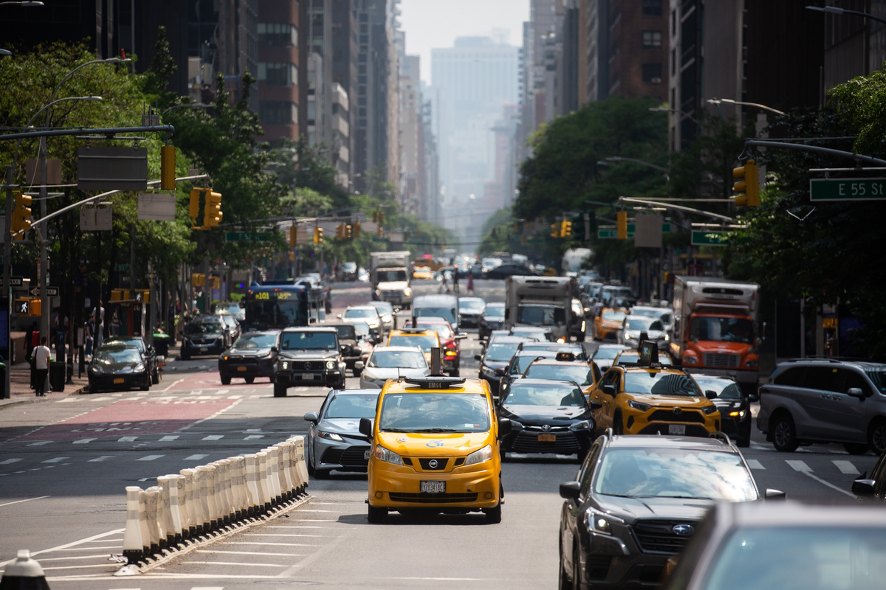
Many people daily use taxi services around the world to move around urban areas. Some do not own cars while others do not intentionally drive their cars due to their busy schedule.
Uber is one of the world leaders in this field.

Slide 3


By analyzing Uber trips, we can depict many patterns, such as
- The day with the highest and lowest trips.
- The busiest hours for Uber and many other patterns.
The dataset we will use here is based on Uber trips in New York City, a city with a complex transportation system. With a very large population.

Slide 4

The dataset we have about 4.5 million trips in New York City for the months of April through September.
In the period between January and June, about 14.3 million trips took place
Our analysis will be for only September it contains about 1.02 million trips

Slide 5
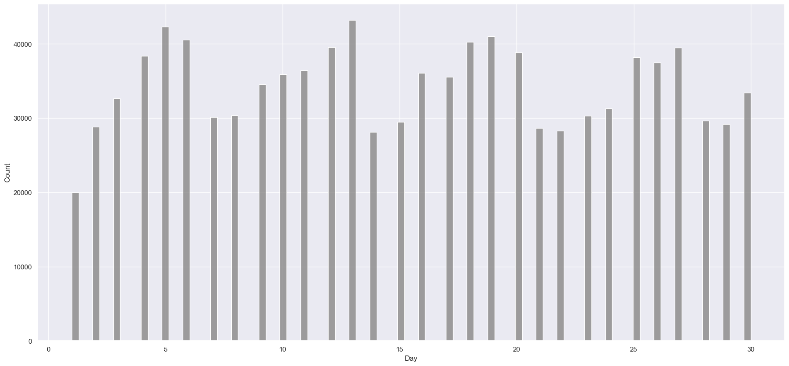
Analysis of Uber trips in September 2014
Trips increase gradually from the beginning of the week until the end.
The number of flights on September 1, 2014 is 20,000 Trips.

Slide 6
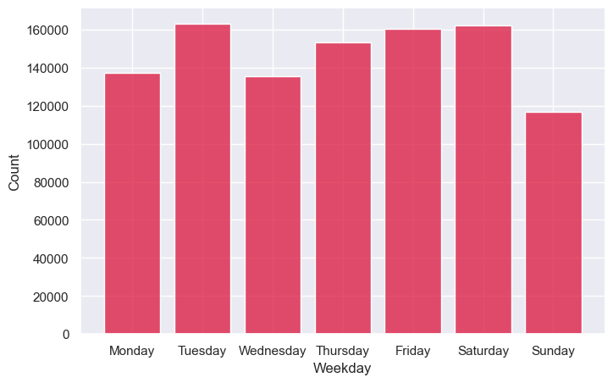
Number of Trips during weekdays in September
It seems that people in New York prefer to rest at home on Sunday to prepare for a busy week

Slide 7
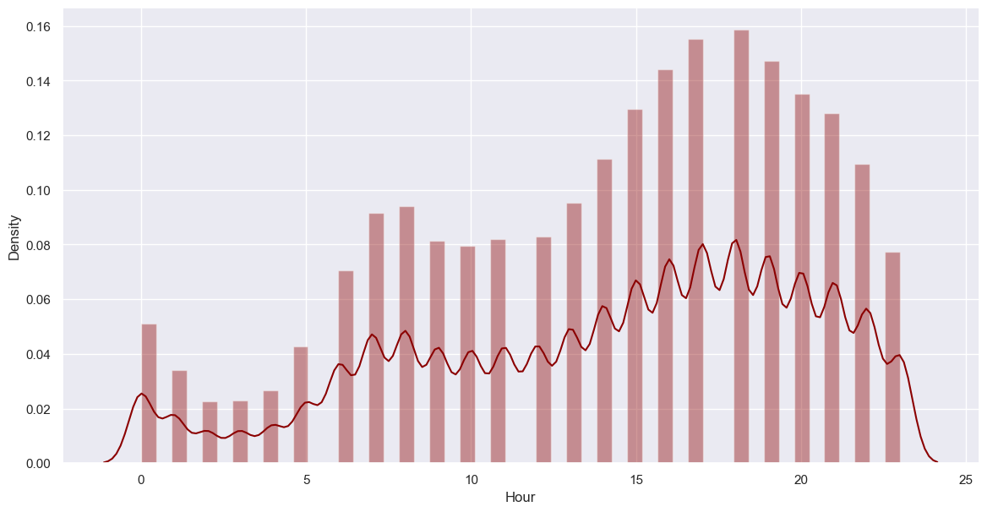
Peak hours (largest number of requests for Uber trips during the day)
Peak hours extend from 15:00 to 21:00, i.e. from 03:00 pm to 9:00 pm.
The maximum peak hour of the day is at 18:00, i.e. 6:00 PM

Slide 8
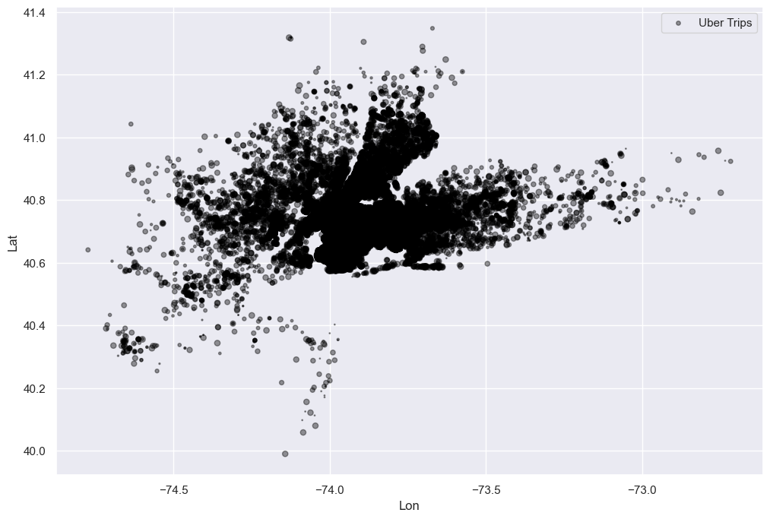
Since we have data about latitude and longitude, we can also plot the density of Uber trips according to the areas in New York City
The region with the most requests for Uber is located between longitude -73.99 and latitude 40.75.

Slide 9
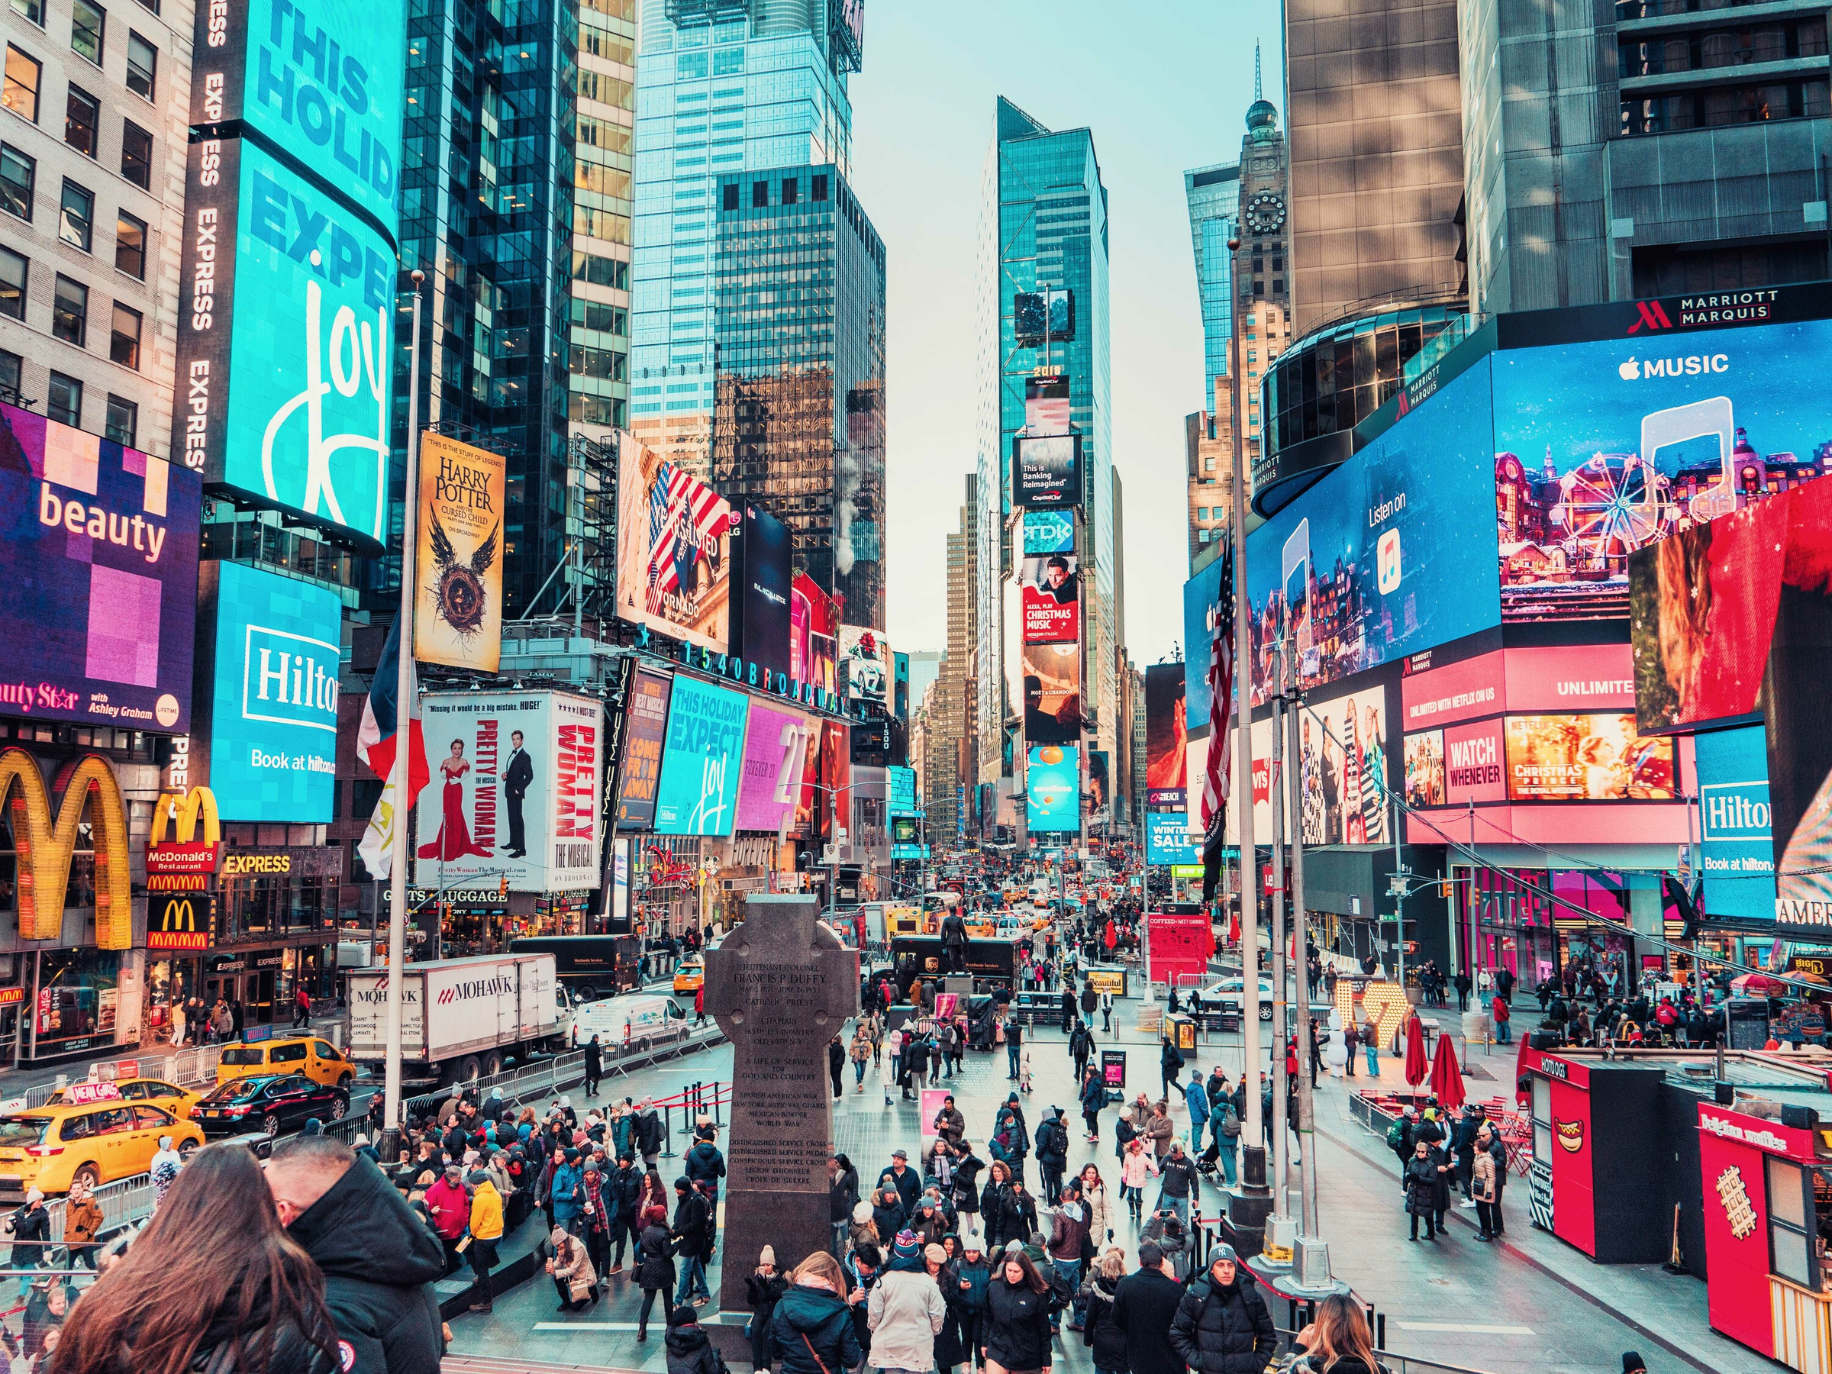
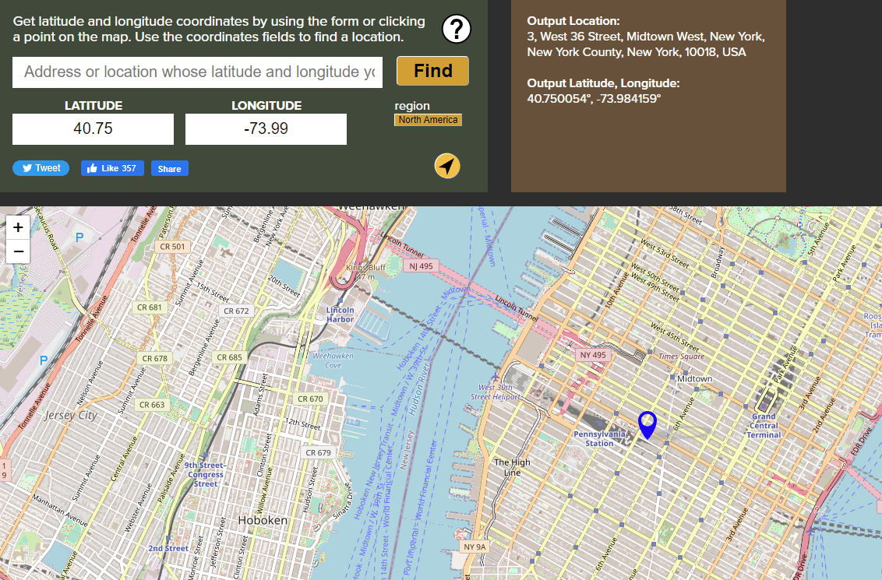
The middle of New York City, which is known as Midtown in Manhattan

Slide 10
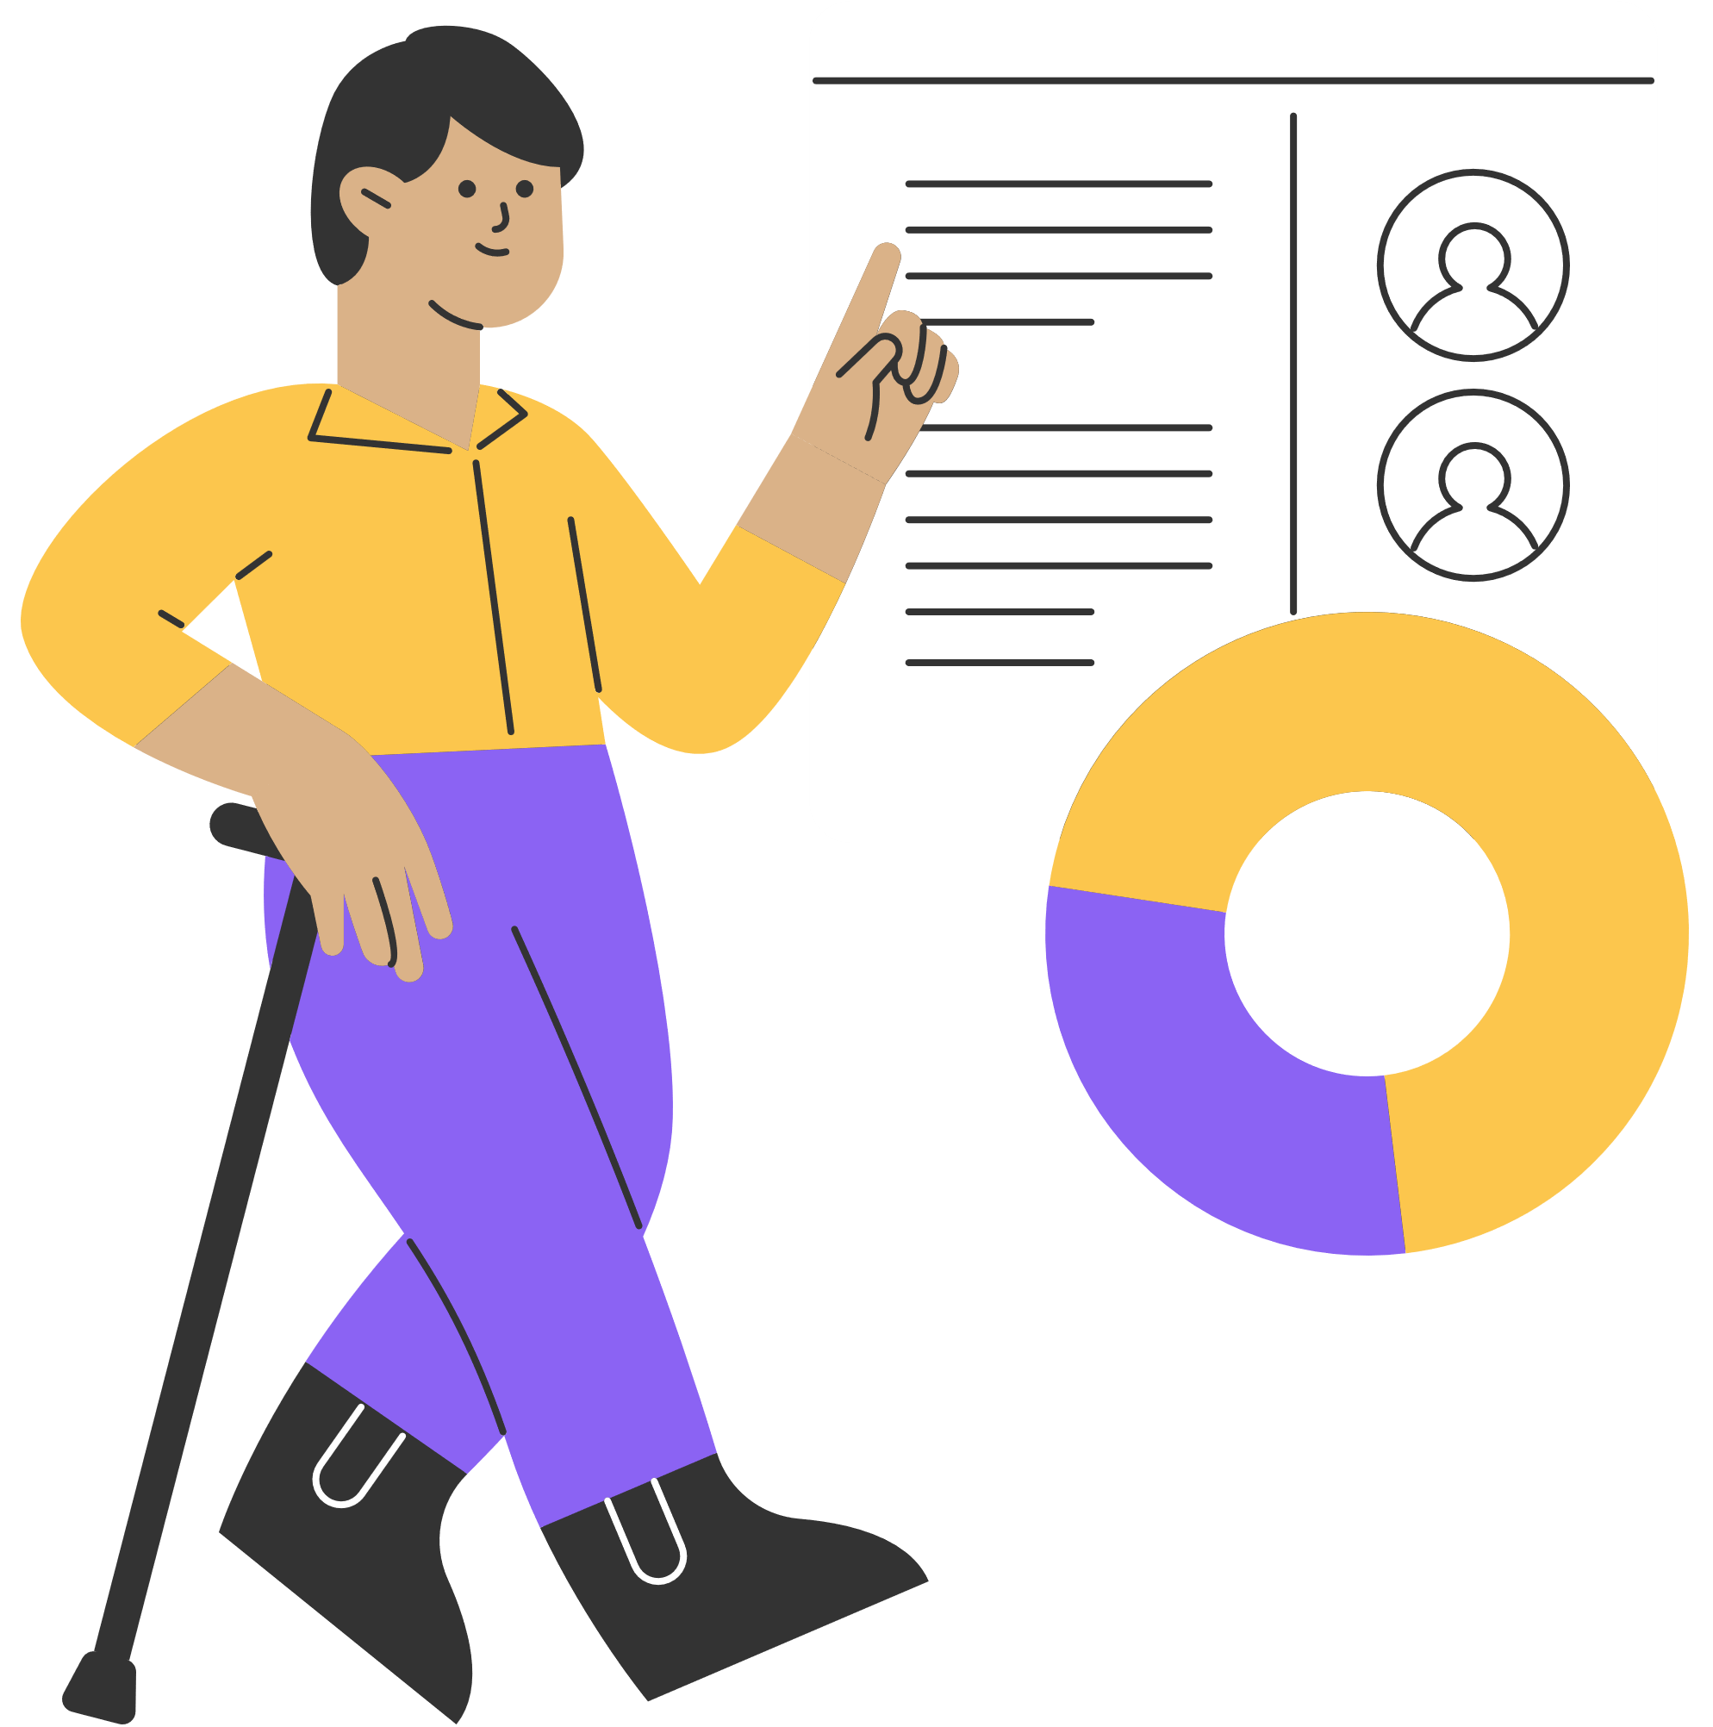
Summary
Tuesday is Uber's most profitable day in September.
The number of flights increases gradually from the beginning of the week until the end.
On Sundays, fewer people use Uber.
6:00 PM is Uber's peak rush hour in New York City.
Most Uber trips start near Manhattan, New York.

Slide 11


THANK YOU
elbhbaty@gmail.com

